Slide 1
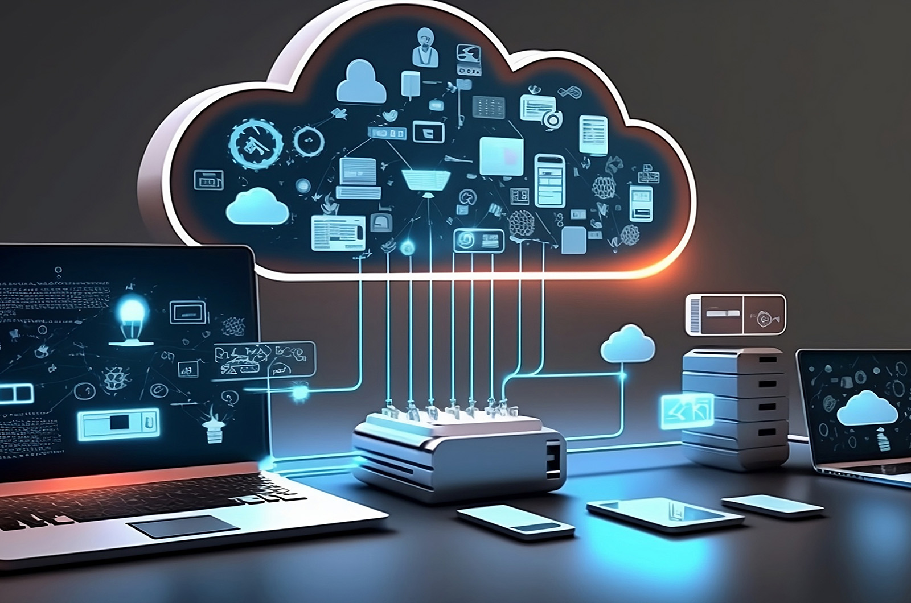
CLOUD COMPUTING

Slide 2
UNIT-1
Introduction to Cloud Computing : Cloud Computing in a Nutshell ,Roots of Cloud Computing ,Layers and Types of Clouds ,Desired Features of a Cloud ,Cloud Infrastructure Management ,Infrastructure as a Service Providers ,Platform as a Service Providers.
Migrating into a Cloud : Introduction ,Broad Approaches to Migrating into the Cloud ,The Seven-Step Model of Migration into a Cloud.
Enriching the ‘Integration as a Service’ Paradigm for the Cloud Era : An Introduction ,The Onset of Knowledge Era ,The Evolution of SaaS ,The Challenges of SaaS Paradigm ,Approaching the SaaS Integration Enigma , New Integration Scenarios, The Integration Methodologies ,SaaS Integration Products and Platforms ,SaaS Integration Services ,Businesses-to-Business Integration (B2Bi) Services ,A Framework of Sensor—Cloud Integration.

Slide 3
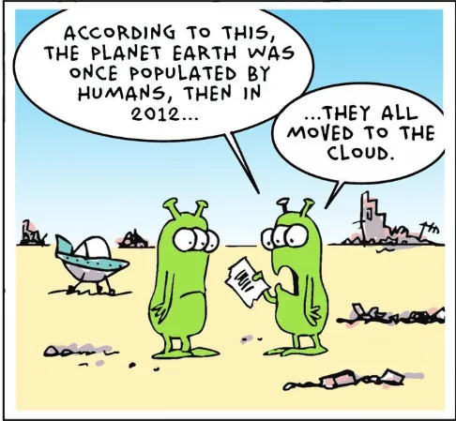
What Is Cloud Computing?
Cloud computing is a general term for anything that involves delivering hosted services over the Internet
Cloud computing refers to the use of hosted services, such as data storage, servers, databases, networking, and software over the internet.
The data is stored on physical servers ,which are maintained by a cloud service provider.
Cloud Benefits
Pay as you go
Focus on business rather than IT
Elasticity - Scale up and down based on business need

Slide 4
Essential Characteristics
On Demand Self-Service: Allows for provisioning of computing resources automatically as needed.
Broad Network Access: Access to cloud resources is over the network using standard mechanisms provided through multi-channels.
Resource Pooling: The vendors resources are capable of being pooled to serve multiple clients using a multi-tenant model, with different physical and virtual resources in a dynamic way.
Example of resources include; computation capabilities, storage and memory.
Rapid Elasticity: Allows for rapid capability provisioning, for quick scaling out and scaling in of capabilities. The capability available for provisioning to the client seems to be unlimited and that it can be purchased as demanded.
Measured Service: Allows monitoring, control and reporting of usage. It also allows for transparent between the provider and the client.

Slide 5
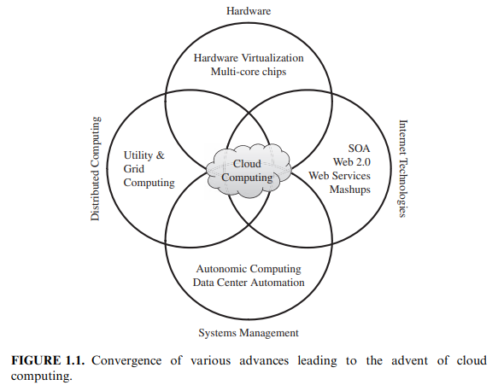

Roots of Cloud Computing
The basic roots of cloud computing can be traced back to several key technologies and concepts that evolved over time:
From Mainframes to Clouds:
Mainframe Era (1950s-1970s): In the early days of computing, large, expensive mainframe computers were the primary way to access computing power. These machines were typically housed in central locations and accessed by multiple users through terminals. The mainframe era laid the groundwork for the concept of shared computing resources.

Slide 6
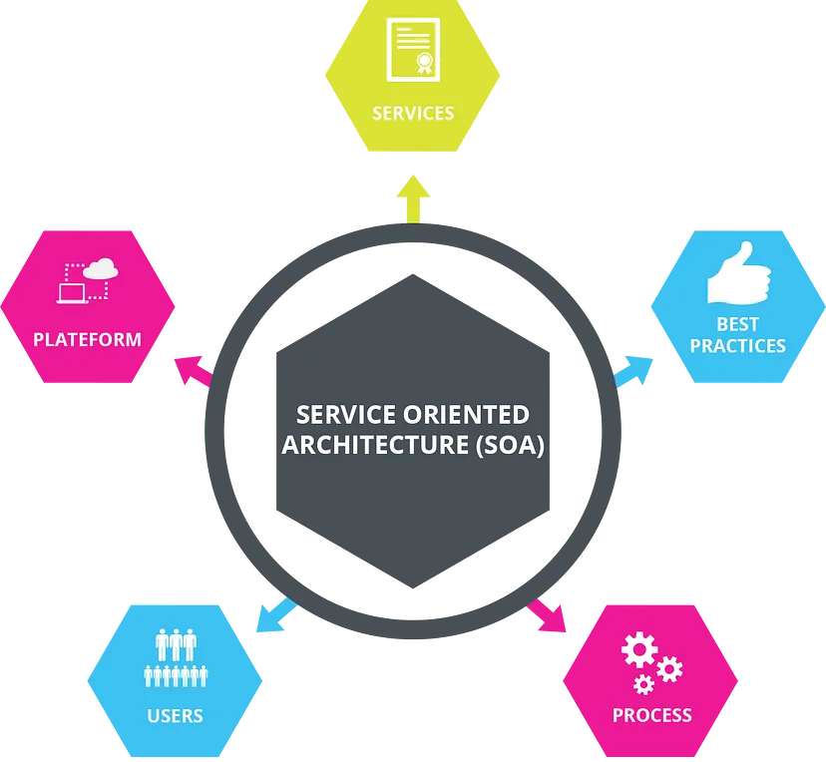
SOA, Web Services
Web services (WS) open standards have appreciably throw in to advance domain of software assimilation. WS standards have been created on top of existing ubiquitous technologies such as HTTP, XML, thus providing a common mechanism for delivering services, making them ideal for implementing a service-oriented architecture i.e. SOA.
Service-Oriented Architecture (SOA) (1990s): The concept of service-oriented architecture (SOA) emerged in the 1990s. SOA breaks down applications into smaller, independent services that can be accessed and combined over a network. This modular approach to software development is a key principle behind cloud computing, where applications can be built using on-demand cloud services.

Slide 7
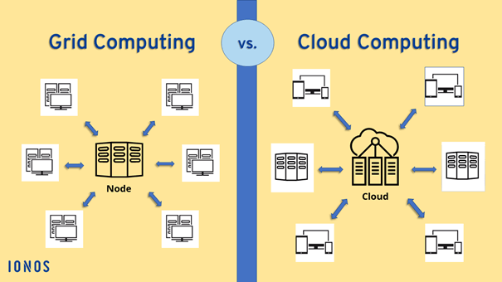
Grid & Utility Computing
Grid Computing (1990s-2000s): Grid computing is a type of distributed computing that allows for the sharing of computing resources across a large network of computers.
Grid computing helped to establish the concept of resource pooling, which is a fundamental principle of cloud computing.
Grid computing facilitates aggregation of distributed resources and transparently accesses them. Most production grids TeraGrid, EGEE share more computable and storage resources distributed across different administrative domains with their main intension is speeding up a broad range of scientific application such as climate modeling, drug design and protein analysis.
Globus Toolkit is a middleware that implements several standard Grid services and over the years has abet the deployment of several service oriented.

Slide 8
Utility Computing: Utility computing is a model where computing resources are provided as a metered service, similar to traditional utilities like electricity or water. This concept influenced the pay-as-you-go pricing model of cloud computing, where users pay only for the resources they consume.
In utility computing environments users assign a "utility" value to their jobs, where utility is a fixed or time-varying value that captures various QoS constraints ( deadline, satisfaction).The service providers attempt their own utility , where said utility may directly correlate with their profit.
Hardware Virtualization
Cloud computing services are usually backed by large-scale data centers composed of thousands of computers. Such data centers are built to serve many users and host many disparate applications. For this purpose, hardware virtualization can be considered as a perfect fit to overcome most operational issues of data center building and maintenance

Slide 9
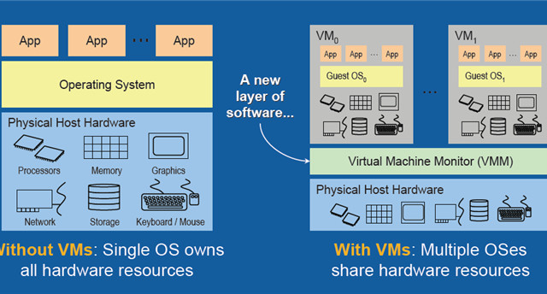
Virtualization (1960s-present): Virtualization technology, which allows for the creation of multiple virtual machines on a single physical server, played a crucial role in the development of cloud computing. Virtualization enabled the efficient utilization of computing resources and made it possible to provision and scale resources on-demand

Slide 10
Autonomic computing is a computer’s ability to manage itself automatically through adaptive technologies that further computing capabilities and cut down on the time required by computer professionals to resolve system difficulties and other maintenance such as software updates.
The autonomic computing initiative (ACI), which was developed by IBM, demonstrates and advocates networking computer systems that do not involve a lot of human intervention other than defining input rules. The ACI is derived from the autonomic nervous system of the human body.
IBM has defined the four areas of automatic computing:
Self-Configuration.
Self-Healing (error correction).
Self-Optimization (automatic resource control for optimal functioning).
Self-Protection (identification and protection from attacks in a proactive manner).

Slide 11
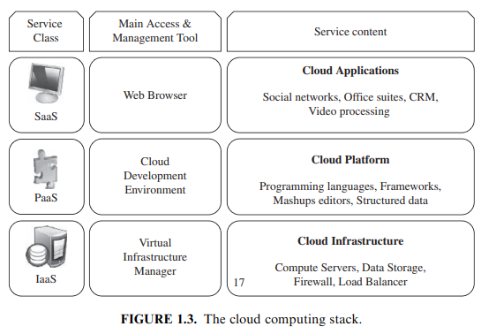
LAYERS AND TYPES OF CLOUDS
Cloud computing is delivered through a layered architecture that provides a variety of services to users. These layers can be broadly categorized into three main parts:

Slide 12
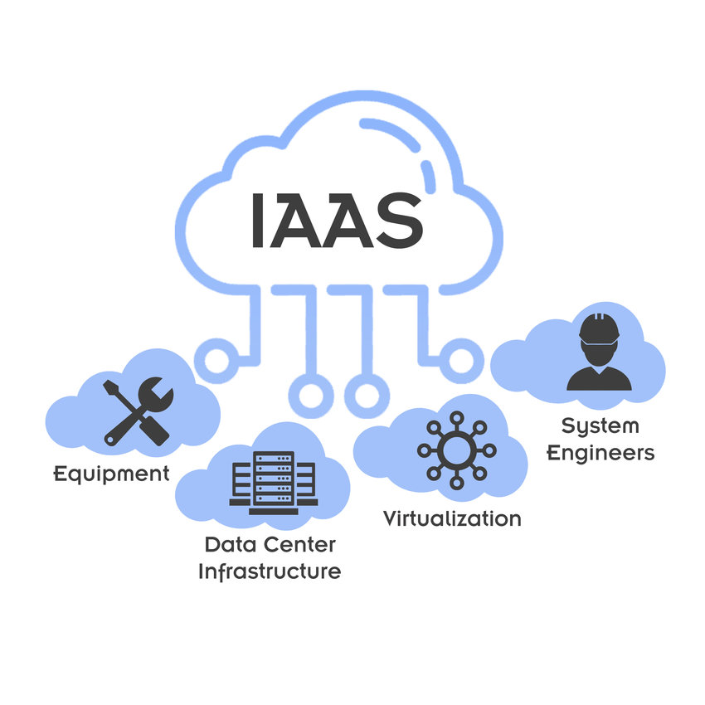
Infrastructure as a Service (IaaS): The IaaS layer is the foundation of cloud computing. It provides the basic building blocks for computing, such as servers, storage, networking hardware, firewalls, load balancers, and virtualization software. Users can rent these resources on-demand and scale them up or down as needed.
Amazon EC2 is an example of IaaS which provides scalable compute capacity in the cloud. Basically, consumers get a machine that they customize and use.
Infrastructure as a Service (IaaS) -services like AWS EC2, VMs, Containers, Google's cloud etc. are common IaaS cloud services

Slide 13
Platform as a Service (PaaS): The PaaS layer sits on top of the IaaS layer and provides a platform for developing, deploying, and managing applications. It includes tools for building applications, databases, middleware, development tools, and runtime environments. PaaS removes the need for users to manage the underlying infrastructure, allowing them to focus on developing and deploying their applications
App Engine is a PaaS offering from Google. Applications are developed and deployed on Google infrastructure. Google App Engine uses big table to store data. This is an example of platform specific development, a change that traditional developers will have to face when they move to App Engine. It does not support relational databases.
Force.com is a PaaS offering from Salesforce. Developers can create applications that run on the force.com platform. It includes database, workflow and UI tools. Applications can be built using their proprietary Apex programming language or using Visual Force (a tag based markup language).

Slide 14
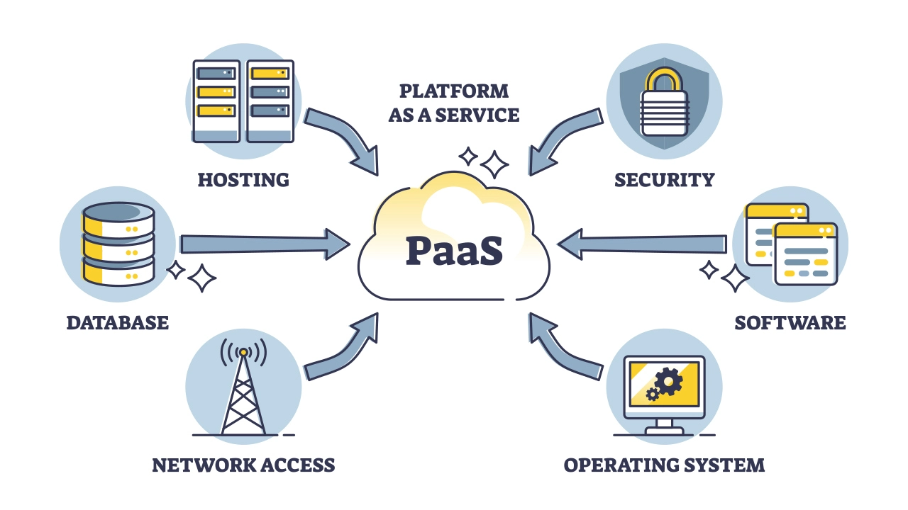
Microsoft Azure is Microsofts platform as a service offering. It includes an OS with .NET runtime, a database (SQL Azure) and other services that make it easier to couple on-premise and off-premise applications.

Slide 15
Software as a Service (SaaS):
The SaaS layer is the topmost layer of the cloud computing stack. It delivers on-demand software applications over the internet.
Users access these applications through a web browser or a mobile app and pay for them on a subscription basis.
SaaS eliminates the need for users to install and maintain software on their own devices.
web based email services such as Gmail, Hotmail etc are SaaS applications. Two features of a SaaS application are scalability and configurability.
SaaS applications should be able to quickly scale with demand. In mature SaaS applications, the customer should be able to customize their instance of the software using meta-data.
Depending on who you talk to multi-tenancy is yet another feature of SaaS applications. Multiple customers share a single instance of the software and the provider can optimize the resources to suit individual demands.

Slide 16
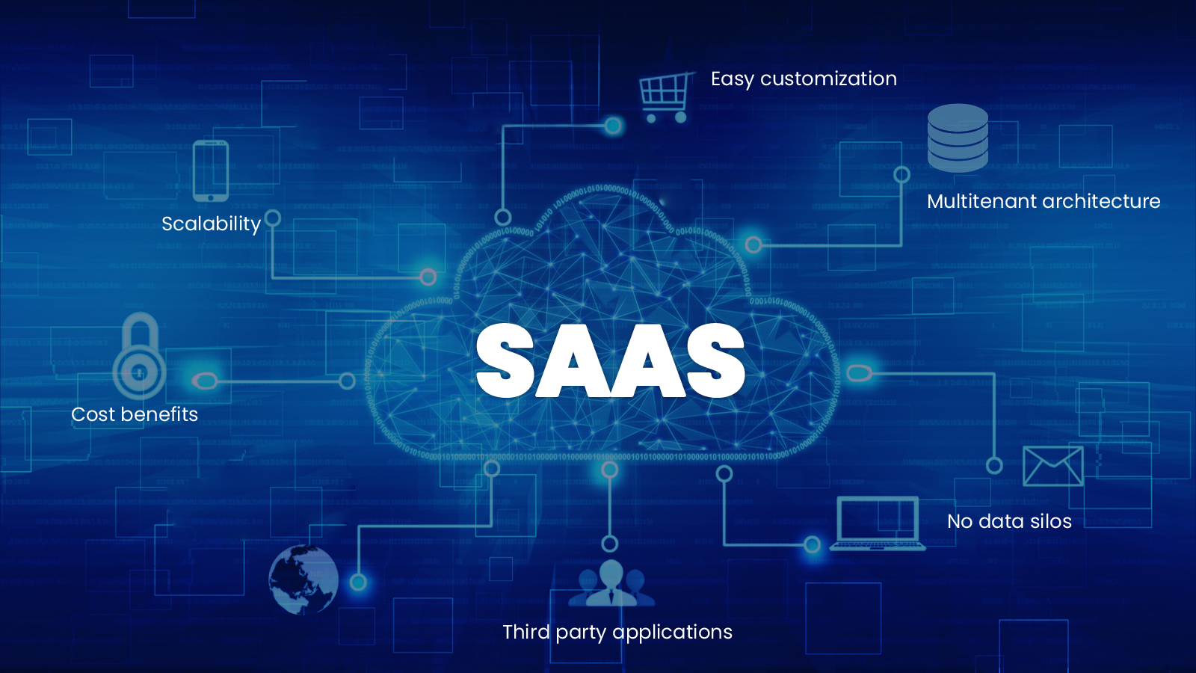
Google Apps - a SaaS version of desktop applications where the software is hosted on google servers. Salesforce - SaaS CRM products.

Slide 17
SaaS | PaaS | IaaS
We, the end-users, mostly use the SaaS cloud model. | Creators and developers mainly use the PaaS cloud model. | Network architects or network engineers mostly use the IaaS cloud model.
We do not need hard-core technical proficiencies to understand or use the SaaS cloud model. | We should have a basic understanding and knowledge of the concerned subject before utilizing the PaaS model. | We will require technical knowledge and expertise to handle and manage IaaS services.
It is prominent among consumers, end users, and companies that want to share their apps and software with the masses. | This model is prominent among developers and creators who focus on developing apps and programs online. | This model is popular among network architects, engineers, researchers, and companies that want a cloud-based remote infrastructure service as a lease instead of in-house hardware for computation and storage.
The SaaS model delivers various software and applications as a service to customers and end-users, primarily on a subscription basis. | The PaaS model delivers various development environments and creative platforms as a service to end-users, who are mainly developers and creators, primarily on a subscription basis. | The IaaS model delivers various hardware components as rented services to different companies, primarily on a subscription basis.
Cloud service providers (CSPs) provide this service through software or apps hosted on the cloud. | Cloud service providers (CSPs) typically provide this service through platforms or development environments. Such development environments provide us with tools and development features to make application development easy. | Cloud service providers (CSPs) provide this service through dashboards or APIs. Such dashboards provide us with complete control over the entire hardware infrastructure.
Examples of SaaS are Google Workspace, Google apps, Netflix, Instagram, etc. | Examples of PaaS are the Google search engine, Canva, Github, etc. | Examples of IaaS are VCloud Express, Google Cloud Platform (GCP), IBM Cloud, AWS, etc.

Slide 18
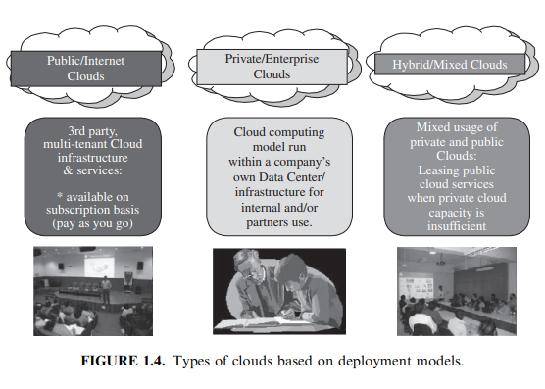
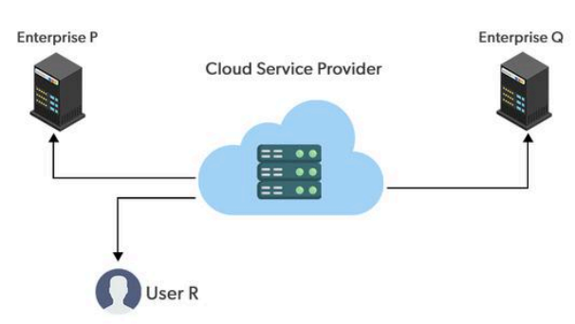
Types of Cloud
Deployment Models define where the cloud infrastructure is located and how it's accessed:
Public Cloud: This is the most common type of cloud deployment. Public cloud resources are owned and operated by a cloud service provider (CSP) like Amazon Web Services (AWS), Microsoft Azure, or Google Cloud Platform (GCP). They offer on-demand, self-service access to computing resources over the public internet. Public clouds are generally cost-effective and scalable, making them a good choice for many businesses.

Slide 19
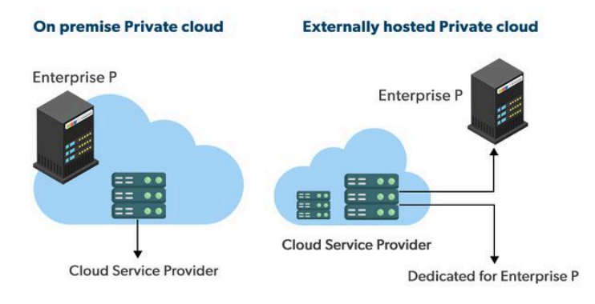
Private Cloud: A private cloud is a cloud infrastructure that is dedicated to a single organization. It can be located on-premises or hosted by a service provider. Private clouds offer greater security and control over the underlying infrastructure but can be more expensive to manage than public clouds.
Hybrid Cloud: A hybrid cloud combines a public cloud with a private cloud. This allows organizations to leverage the benefits of both models, such as the scalability and cost-effectiveness of the public cloud and the security and control of the private cloud.

Slide 20
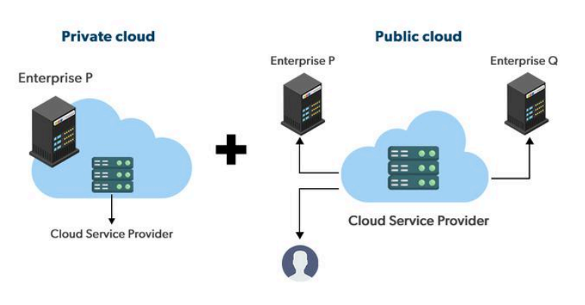
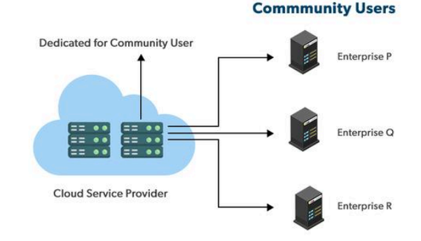
Multi-Cloud(Community): A multi-cloud strategy involves using multiple public clouds from different providers. This can help organizations avoid vendor lock-in and take advantage of the best features and services from each cloud provider.
(e.g., mission, security requirements, policy, and compliance considerations)

Slide 21
DESIRED FEATURES OF A CLOUD
Certain features of a cloud are essential to enable services that truly represent the cloud computing model and satisfy expectations of consumers, and cloud offerings must be (i) self-service, (ii) per-usage metered and billed, (iii) elasticity (iv) customizable (v)security
Self-service On-Demand
This is one of the most essential and significant characteristics of cloud computing. This means that cloud computing enables clients to regularly monitor the abilities, allotted network storage, and server uptime. this helps to clients control various computing abilities as per their requirements.
Per-usage metered and billed
This kind of service is economical as it efficiently reduces IT costs and data storage expenditure. Moreover, most cloud computing services are free. Even if there are paid plans, it’s only to expand storage capacity, and these costs are often very nominal. This is a massive advantage of using cloud computing services.

Slide 22
Elasticity
Cloud computing gives the illusion of infinite computing resources available on demand. Therefore users expect clouds to rapidly provide resources in any quantity at any time
The best part of using cloud storage is that it can easily handle all the workload and data load concerning storage.
Customizable
In a multi-tenant cloud a great disparity between user needs is often the case. Thus, resources rented from the cloud must be highly customizable. In the case of infrastructure services, customization means allowing users to deploy specialized virtual appliances and to be given privileged (root) access to the virtual servers. Other service classes (PaaS and SaaS) offer less flexibility and are not suitable for general-purpose computing , but still are expected to provide a certain level of customization
Security
one of The best features of cloud computing is that it’s secure. Clients hardly face any threat of piracy or data breach concerning the content uploaded overcloud. There is no threat of Trojans or viruses damaging the stored data. Even if the device happens to be infected, cloud data is safe from such harm.

Slide 23
CLOUD INFRASTRUCTURE MANAGEMENT
Cloud infrastructure consists of all of the hardware and software elements needed for cloud computing, including:
Compute (server)
Networking
Storage
Virtualization resources
Cloud infrastructure types usually also include a user interface (UI) for managing these virtual resources.
The software toolkit responsible for this orchestration is called a virtual infrastructure manager (VIM)
Infrastructure as a Service, or IaaS, is a prominent and accessible example of this model. With IaaS, a team or enterprise acquires the computing infrastructure it needs over the Internet, including computing power (whether on physical or, more likely, virtual machines), storage and plenty of related needs such as load balancers and firewalls. They do this in lieu of provisioning and managing their own physical infrastructure. Instead, they lease the resources they need from the IaaS provider.

Slide 24
Features
Cloud infrastructure management tools offer a variety of features to help organizations oversee and optimize their cloud resources. Here are some key functionalities:
Automation: Repetitive tasks like provisioning, scaling, and maintenance can be automated using scripts and pre-defined workflows. This frees up IT staff for more strategic initiatives.
Provisioning and Management: Cloud infrastructure management tools provide a centralized console to manage resources like servers, storage, and networking across the cloud environment. This simplifies deployment and configuration.
Performance Monitoring and Optimization: These tools offer insights into resource utilization, performance metrics, and potential bottlenecks. This allows for proactive management and optimization of resource allocation for better application performance.
Cost Management: Cloud bills can spiral out of control if not monitored closely. Cloud infrastructure management tools provide cost transparency with features like usage reporting, budgeting, and reserved instance management. This helps identify cost-saving opportunities.

Slide 25
Security and Compliance: Security features like role-based access control and encryption help secure cloud resources and user access. Compliance tools ensure adherence to relevant data privacy regulations.
Disaster Recovery and Backup: These tools facilitate data backup and disaster recovery plans to ensure business continuity in case of outages or disruptions.
Multi-Cloud and Hybrid Cloud Management: As organizations embrace complex cloud environments spanning multiple providers or on-premises infrastructure, cloud management tools offer features to manage these hybrid or multi-cloud deployments seamlessly.

Slide 26
INFRASTRUCTURE AS A SERVICE PROVIDERS
Public Infrastructure as a Service providers commonly offer virtual servers containing one or more CPUs, running several choices of operating systems and a customized software stack. In addition, storage space and communication facilities are often provided.
Features
IaaS offerings can be distinguished by the availability of specialized features that influence the cost benefit ratio to be experienced by user applications when moved to the cloud.
Geographic Presence: To improve availability and responsiveness, a provider of worldwide services would typically build several data centers distributed around the world. For example, Amazon Web Services presents the concept of “availability zones” and “regions” for its EC2 service.

Slide 27
Advance Reservation of Capacity: Advance reservations allow users to request for an IaaS provider to reserve resources for a specific time frame in the future, thus ensuring that cloud resources will be available at that time. However, most clouds only support best-effort requests; that is, users requests are server whenever resources are available.
Automatic Scaling and Load Balancing: Automatic scaling is a highly desirable feature of IaaS clouds. It allow users to set conditions for when they want their applications to scale up and down, based on application-specific metrics such as transactions per second, number of simultaneous users, request latency, and so forth.
Service-Level Agreement: Service-level agreements (SLAs) are offered by IaaS providers to express their commitment to delivery of a certain QoS. To customers it serves as a warranty. An SLA usually include availability and performance guarantees. Additionally, metrics must be agreed upon by all parties as well as penalties for violating these expectations.

Slide 28
PLATFORM AS A SERVICE PROVIDERS
Public Platform as a Service providers commonly offer a development and deployment environment that allow users to create and run their applications.
In addition, specific programming languages and frameworks are made available in the platform, as well as other services such as persistent data storage and in memory caches.
Features
Development Tools and Frameworks: Public PaaS offers a set of development tools, programming languages, and frameworks optimized for their platform. This reduces development time and effort compared to building everything from scratch.
Limited Customization: While Public PaaS offers flexibility, there might be limitations on how extensively users can customize the underlying infrastructure. This can be a drawback for applications with very specific requirements.

Slide 29
Application Deployment and Management: Public PaaS platforms provide tools for deploying, managing, and monitoring applications. This includes features for version control, continuous integration/continuous delivery (CI/CD), and application logging.
Security: Public PaaS providers take care of core infrastructure security. They offer features like firewalls, intrusion detection, and access control to safeguard applications and data. However, users might still be responsible for securing their specific applications and data within the platform.
Cost-Effectiveness: Public PaaS typically follows a pay-as-you-go model. Users only pay for the resources they use, making it a cost-effective solution for development projects of various sizes.

